Slide 1
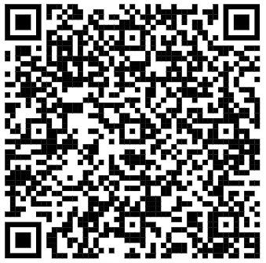
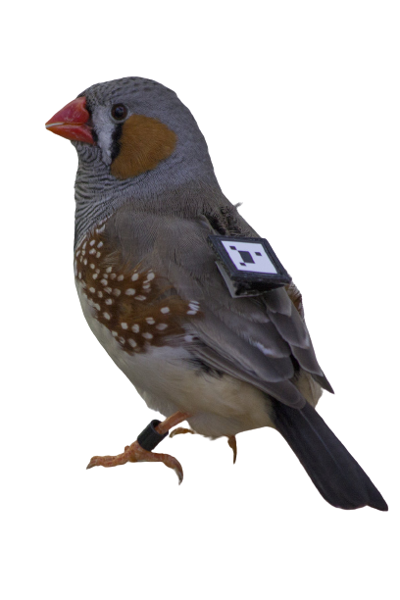
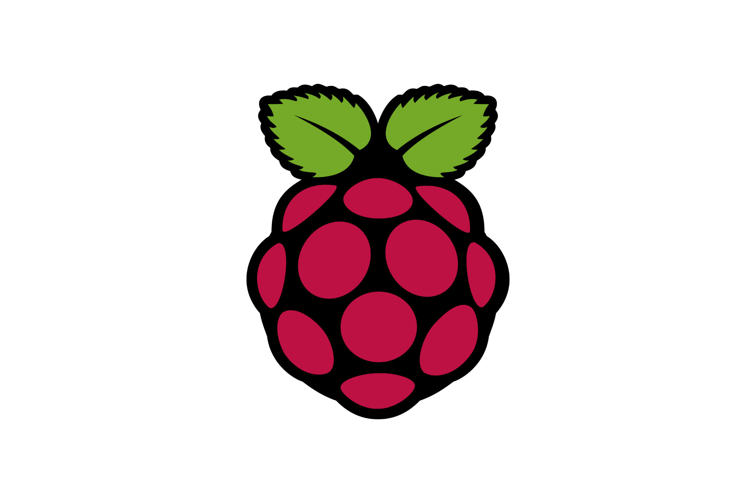
Sprint 2 Demo
Team Birds Are(n’t) Real
Zach Burgess, Grant Rainey,
David Schneidau, Carmen Accampo

Slide 2

Goals for Sprint 2
Order and assemble remaining Raspberry Pi hardware
(cables cameras splitters etc.)
Connect QR code detection to Google BigQuery Cloud
Calculate distances between QR codes
Successfully detect and log QR code data to BigQuery

Slide 3
Sprint 2 Achievements 🏆
Tested detection on both live video feed and individual images
Booted the operating system on the RPi
Created virtual connection to RPi
Tested RPi camera
Visualization to display bounding boxes around detected QR codes
Ability to detect all QR codes in an image simultaneously
Have general plan for where/how all hardware will be mounted
Achieved proof-of-concept for individualized bird activity summaries

Slide 4
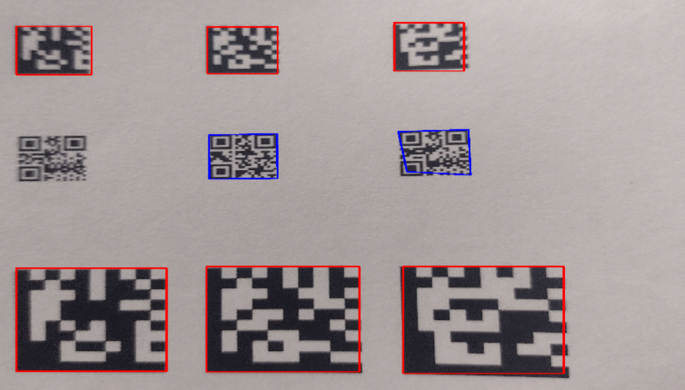
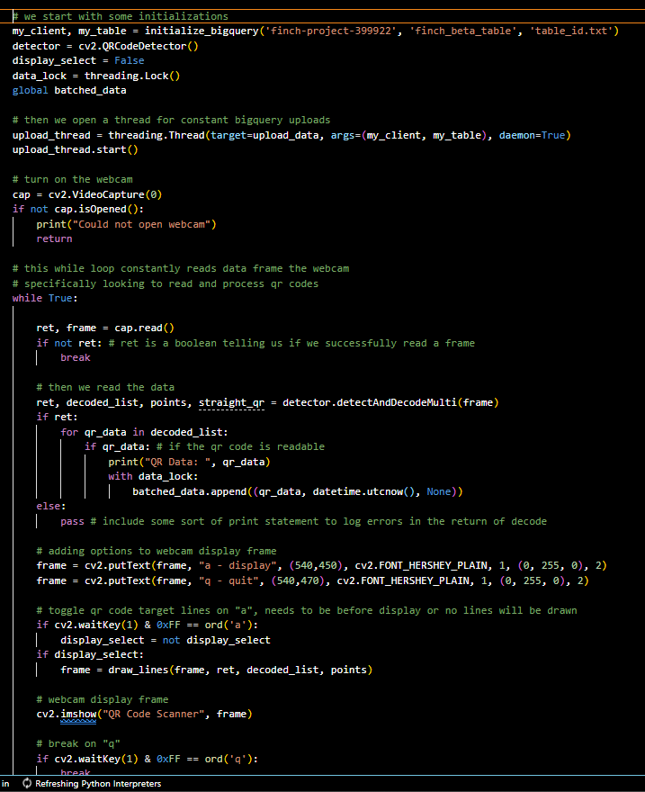

Slide 5
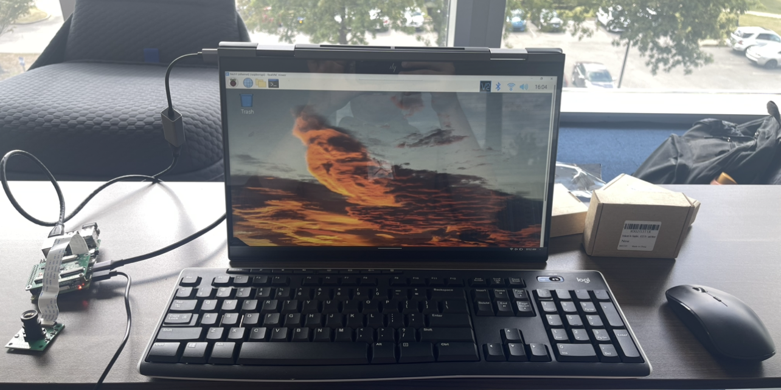
Raspberry Pi Setup Complete (At Last)
AND…

Slide 6
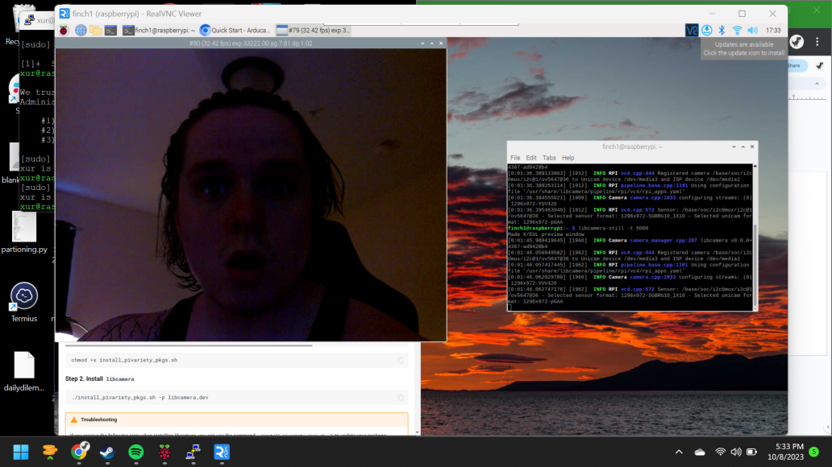
Raspberry Pi Setup Complete (At Last)

Slide 7
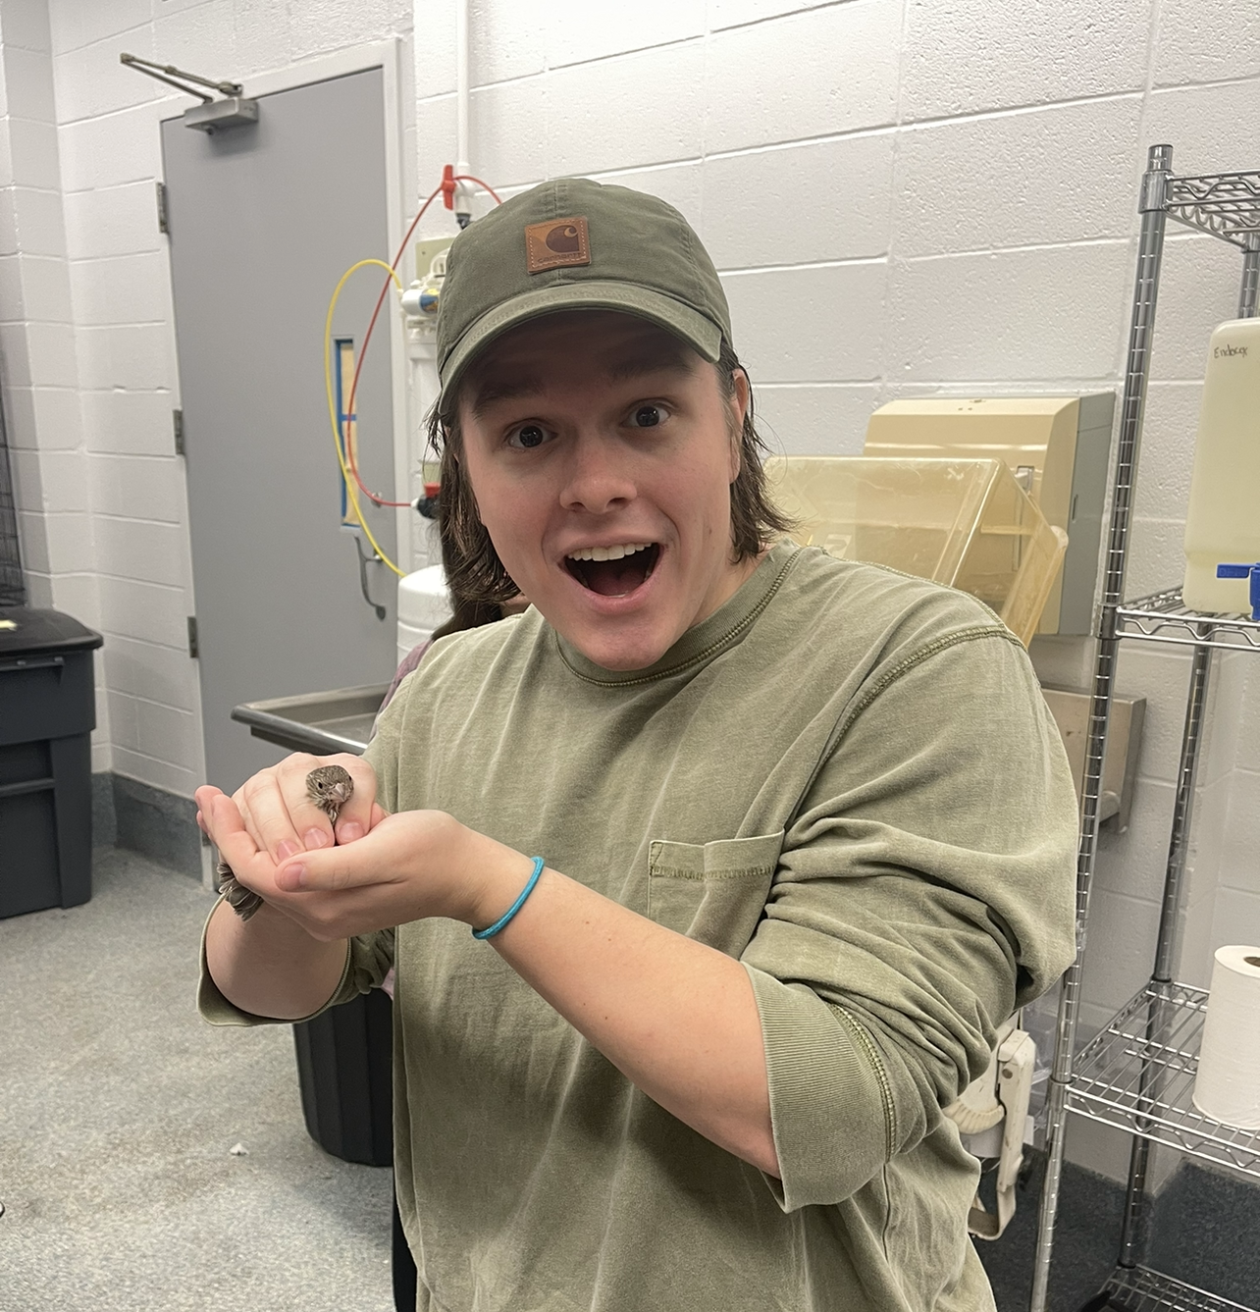
WE GOT TO SEE THE BIRDS!
(Still can not confirm their existence)

Slide 8
Steps for Sprint 3
Get Raspberry Pi streaming data to GCP’s BigQuery Database.
Begin installation/positional optimization of the Raspberry Pi cameras.
Work on error handling and “defensive programming” (Code Review)
Explore most optimal remote access/software deployment methods for RPI
Integrate distance formula/positional data formatting into bird activity summaries

